Slide 1
Lecture 24
Software Project Planning
BSCS(Software Engineering-II) SZABIST-Islamabad

Slide 2
Software Project Planning
The project planning process involves a set of interrelated activities followed in an orderly manner to implement user requirements in software and includes the description of a series of project planning activities and individual(s) responsible for performing these activities.
BSCS(Software Engineering-II) SZABIST-Islamabad

Slide 3
Software Project Planning Stages
At the proposal stage, when you are bidding for a contract to develop or provide a software system.
During the project startup phase, when you have to plan who will work on the project, how the project will be broken down into increments, how resources will be allocated across your company, etc.
Periodically throughout the project, when you modify your plan in the light of experience gained and information from monitoring the progress of the work.
BSCS(Software Engineering-II) SZABIST-Islamabad

Slide 4
Software Project Planning Process
Define the Tasks
Sequence the Tasks
Add Durations
Add Dependencies and Constraints
Add Resources
Level Resources
Is There a Better Way?
Review the Plan
Create a Baseline
BSCS(Software Engineering-II) SZABIST-Islamabad

Slide 5
Software Project Planning Process
1. Define the Tasks
Technique 1: Brainstorm Activities
This technique works best for smaller projects. Here we’re going to brainstorm all the activities that need to be done in order for the work to be completed. To complete this step we simply get all of the team together, agree on the definition of when the project deliverables are complete (this will correspond to the acceptance criteria in your Project Scope Statement), and then as a group list all the activities that need to be done in order to achieve all those criteria.
Example: Requirement, Analysis, Design, Development and Testing
BSCS(Software Engineering-II) SZABIST-Islamabad

Slide 6
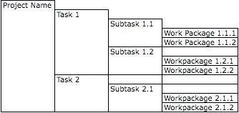
Software Project Planning Process
1. Define the Tasks
Technique 2: Work Breakdown Structure
Dividing complex projects to simpler and manageable tasks is the process identified as Work Breakdown Structure (WBS).
Identifying the main deliverables of a project is the starting point for deriving a work breakdown structure.
BSCS(Software Engineering-II) SZABIST-Islamabad

Slide 7
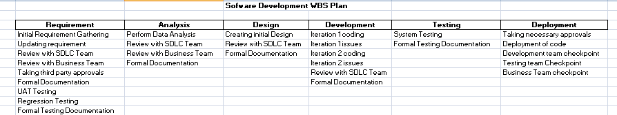
Software Project Planning Process
For example:
BSCS(Software Engineering-II) SZABIST-Islamabad

Slide 8
Software Project Planning Process
2. Sequence the Tasks
Now that we have our full project scope and the deliverables (WBS) for our project plan example, it’s time to start sequencing the activities.
A tool specifically designed for creating Gantt Charts, such as Microsoft Project (a paid tool) or GanttProject (free).
It’s perfectly feasible to create your plan using Microsoft Excel or even pen and paper.
BSCS(Software Engineering-II) SZABIST-Islamabad

Slide 9
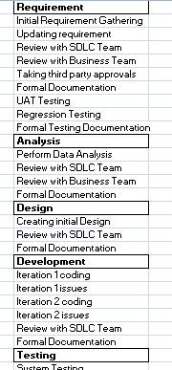
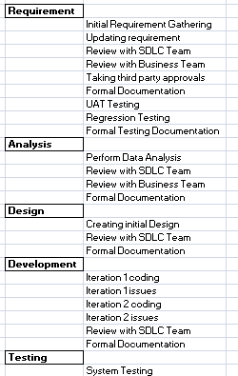
Software Project Planning Process
For example:
BSCS(Software Engineering-II) SZABIST-Islamabad

Slide 10
Software Project Planning Process
3. Add Durations
We now need to enter durations for how long each task in our project plan example will take. We obtain these estimates by asking our team to estimate how long each work package will take when we go through the process of updating both the WBS and the plan:
Requirement gathering 2 weeks etc
Documentation: 1 week
BSCS(Software Engineering-II) SZABIST-Islamabad

Slide 11
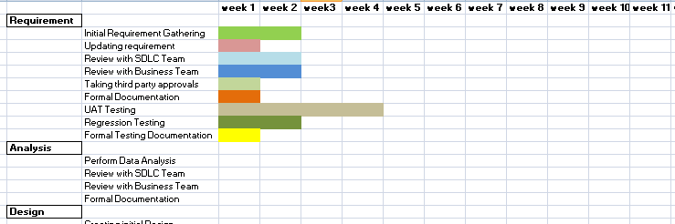
Software Project Planning Process
For example:
BSCS(Software Engineering-II) SZABIST-Islamabad

Slide 12
Software Project Planning Process
4. Add Dependencies and Constraints
Now it is time to add our dependencies and constraints to our project plan example. To do this drag we drag our cursor from one task in the Gantt chart to the next to show which tasks happen after other tasks are completed or before other tasks have started. Having done this our plan is finally beginning to take shape:
For example: Testing cannot start before the development finish etc
BSCS(Software Engineering-II) SZABIST-Islamabad

Slide 13
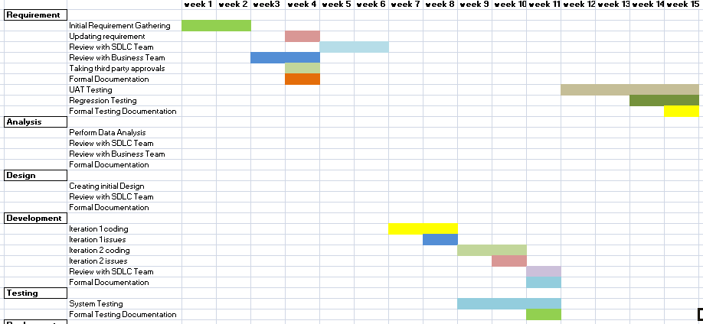
Software Project Planning Process
For example:
BSCS(Software Engineering-II) SZABIST-Islamabad

Slide 14
Software Project Planning Process
5. Add Resources
The next step is to add resources to our project plan example to show who will carry out each task. We do this by entering the Resources tab and entering the name or initials of each resource that will work on the project. You can also allocate a cost to each resource.
For example: who will perform which task
BSCS(Software Engineering-II) SZABIST-Islamabad

Slide 15
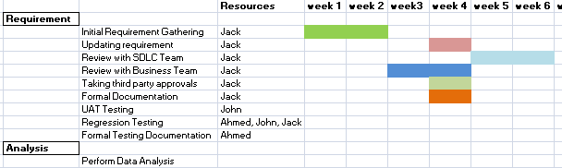
Software Project Planning Process
For example:
BSCS(Software Engineering-II) SZABIST-Islamabad

Slide 16
Software Project Planning Process
6. Level Resources
For example:
The first thing to notice is the red box with 200% written inside it. This means that Jack is assigned 200% on the 4th week, meaning Jack is expected to do two full week work within a single week.
The second thing to notice is the comments box for Jack on the 5-6th week indicating the time Jack is on vacation. That indicates that we expect Jack to do a full Weeks of work even though JR is on vacation.
These two situations obviously are not correct, and the way we resolve them is by a technique known as resource leveling, whereby we try to ensure that we balance the demand for a resource with the supply of that resource.
BSCS(Software Engineering-II) SZABIST-Islamabad

Slide 17
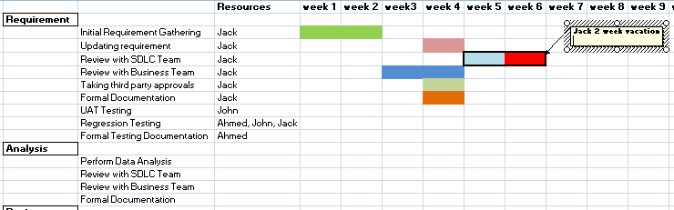
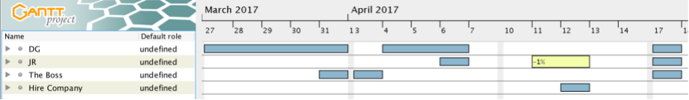
Software Project Planning Process
For example:
BSCS(Software Engineering-II) SZABIST-Islamabad

Slide 18
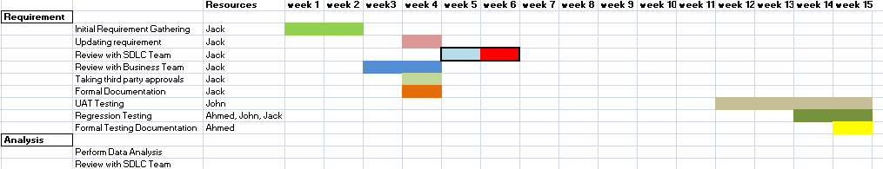
Software Project Planning Process
7. Is There a Better Way?
Let’s examine the plan again to see what ideas we can generate to improve the plan:
BSCS(Software Engineering-II) SZABIST-Islamabad

Slide 19
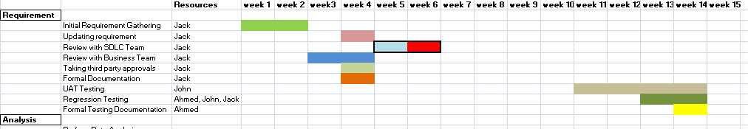
Software Project Planning Process
Example: In-case of any reason if we are unable to finish our testing on time we wont be able to prepare documentation on time. As week 15 is last day.
BSCS(Software Engineering-II) SZABIST-Islamabad

Slide 20
Software Project Planning Process
8. Review the Plan
Now that our project plan example has been created it is time to review it. If you haven’t already done so you should review the plan with your project team taking on board their feedback. This is an important step as your project is more likely to be successful if your team has bought into the plan, and has played a part in co-creating the plan
BSCS(Software Engineering-II) SZABIST-Islamabad

Slide 21
Software Project Planning Process
9. Create the Project Plan Example Baseline
A baseline is simply a snapshot of your project plan, and it is against this baseline that your project status reporting will be done.
When we create:
When our project plan example has been ratified it will have been reviewed by the steering committee and signed off.
When this happens, the initial project plan will be considered finalized, and it will be time to create a baseline of the plan.
BSCS(Software Engineering-II) SZABIST-Islamabad

Slide 22
Software Project Planning Process
Description | Time baseline
Requirement | 3weeks
UAT Testing | 1 week
Regression Testing | 1 week
Analysis | 2 week
Design | 2 week
Development | 4 weeks
Testing | 3 weeks
System Testing | 2 week
Deployment | 1 week
Total | 15 week project
cost baseline | 1.5 million
Resources baseline | 1 Analyst 2 Developer 2 Tester
Code baseline | None/ release 1.4 etc
BSCS(Software Engineering-II) SZABIST-Islamabad

Slide 23
Gantt Chart
Gantt chart is a type of a bar chart that is used for illustrating project schedules.
Gantt charts can be used in any projects that involve effort, resources, milestones and deliveries.
Gantt charts allow project managers to track the progress of the entire project. Through Gantt charts, the project manager can keep a track of the individual tasks as well as of the overall project progression.
BSCS(Software Engineering-II) SZABIST-Islamabad

Slide 24
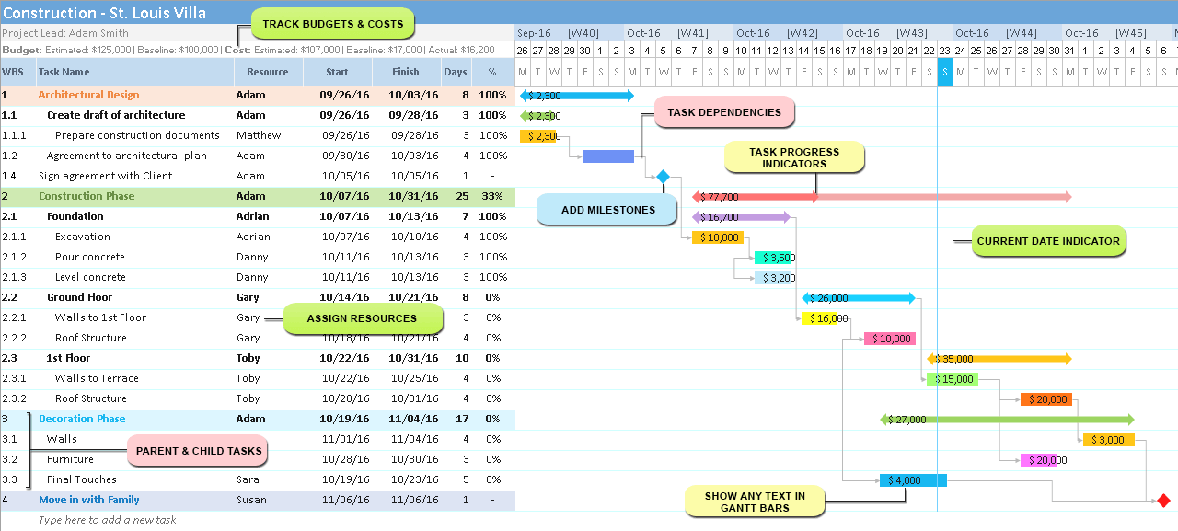
Grant Chart
BSCS(Software Engineering-II) SZABIST-Islamabad

Slide 25
Example
Project Plan excel sheet
BSCS(Software Engineering-II) SZABIST-Islamabad

